Slide 1
Security and Policies
Authentication, Authorization, and Admission.
Resource Management. Network Policies
SoftUni Team
Technical Trainers
Software University
https://about.softuni.bg

Slide 2
Have a Question?
sli.do
#Kubernetes
https://www.facebook.com/groups
/KubernetesOctober2021
Notes:
2

Slide 3
Homework Progress
Submit M2 until 23:59:59 on 14.11.2021
Submit M3 until 23:59:59 on 21.11.2021

Slide 4

Previous Module (M2)
Quick overview

Slide 5
Table of Contents
Basic Cluster Installation
Manage and Upgrade Kubernetes Cluster
Highly-available Kubernetes Cluster
5
Notes:
5

Slide 6

This Module (M3)
Notes:
6

Slide 7
Table of Contents
Authentication, Authorization and Admission Control
Resource Requirements, Limits and Quotas
Network Policies
7
Notes:
7

Slide 8
Authentication, Authorization and Admission Control
Notes:
8

Slide 9
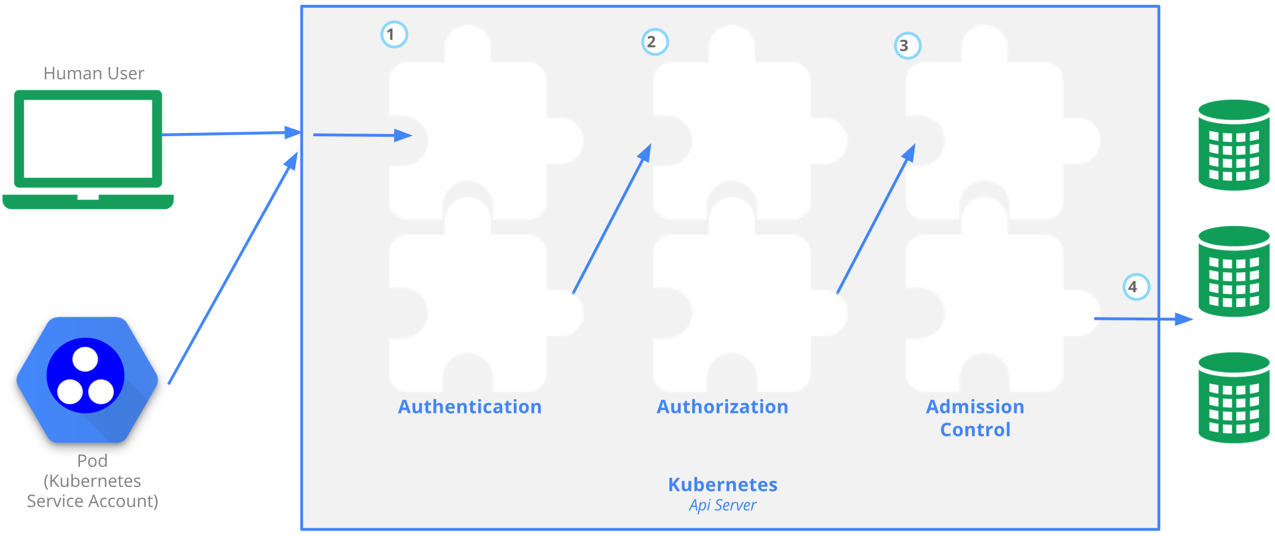
Access Control Overview
https://kubernetes.io/docs/concepts/security/controlling-access/

Slide 10
Authentication
Authentication modules include client certificates, password, and plain tokens, bootstrap tokens, and JSON Web Tokens
Multiple authentication modules can be specified. Each one is tried in sequence, until one of them succeeds
If the request cannot be authenticated, it is rejected with HTTP status code 401
If process succeeds, the user is authenticated as a specific username, and it is available to subsequent steps to use in their decisions
https://kubernetes.io/docs/concepts/security/controlling-access/

Slide 11

Authorization
After a successful authentication, the request must be authorized
It must include the username, the action, and the target object
It is authorized if an existing policy confirms that the user has the right to complete the requested action
Multiple authorization modules are supported, such as ABAC, RBAC, and Webhook
They are configured during the cluster creation
More than one may be specified
All are evaluated until one authorizes the request
If all deny it, then the request is denied (403)

Slide 12
Admission Control
Software modules that can modify or reject requests
In addition to the attributes available to Authorization modules, Admission Control modules can access the contents of the object that is being created or modified
Multiple controllers may be configured. In this case they are called in order
https://kubernetes.io/docs/concepts/security/controlling-access/

Slide 13
Admission Control
If any admission controller module rejects, then the request is immediately rejected
They act on requests that create, modify, delete, or connect to (proxy) an object
They ignore requests that merely read objects
They can also set complex defaults for fields
https://kubernetes.io/docs/concepts/security/controlling-access/

Slide 14
User Accounts vs Service Accounts
When we (humans) access the cluster (for example with kubectl), we are authenticated by the apiserver as a particular User Account (usually admin)
Processes in containers inside pods can also contact the apiserver. When they do, they are authenticated as a particular Service Account (for example, default)
https://kubernetes.io/docs/tasks/configure-pod-container/configure-service-account/

Slide 15
Service Accounts
Each namespace gets one by default named default
During pod creation we can specify a service account
If we omit it, the default one is assigned
Service account names are formatted like this: system:serviceaccount:<namespace>:<service account name>
We can create additional ones to further adjust pods’ rights
Pods can use service accounts from the same namespace
Each pod is attached to only one service account
One service account may be shared by multiple pods
https://kubernetes.io/docs/tasks/configure-pod-container/configure-service-account/

Slide 16
Role-based Access Control (RBAC)
Controls who can do what with which type of resources
Roles contain rules that represent a set of permissions
Permissions are purely additive (there are no "deny" rules)
A role binding grants the permissions defined in a role to a user or set of users
Role bindings hold a list of subjects (users, groups, or service accounts), and a reference to the role being granted
https://kubernetes.io/docs/reference/access-authn-authz/rbac/

Slide 17
Roles and Bindings
Roles set permissions within a namespace
ClusterRoles are non-namespaced resources. They are used to
Grant permissions on namespaced resources within individual namespaces
Grant permissions on namespaced resources across all namespaces
Grant permissions on cluster-scoped resources
https://kubernetes.io/docs/reference/access-authn-authz/rbac/

Slide 18
Roles and Bindings
RoleBinding grants permissions within a specific namespace whereas a ClusterRoleBinding grants that access cluster-wide
RoleBinding may reference any Role in the same namespace or a ClusterRole
If we want to bind a ClusterRole to all namespaces, we must use ClusterRoleBinding
https://kubernetes.io/docs/reference/access-authn-authz/rbac/

Slide 19
Resource Requirements, Limits and Quotas
Notes:
19

Slide 20
Resource Requests and Limits
We can control how much of a resource is granted to a Container
Most common resources are the CPU and memory
We specify how much resources a Container needs to operate via the request option. This information is accumulated on a Pod level and a decision for scheduling of the Pod is made
We restrict how much of a resource a Container can use via the limit option
https://kubernetes.io/docs/concepts/configuration/manage-resources-containers/

Slide 21
CPU
The CPU resource is measured in CPU units
One CPU, in Kubernetes, is equivalent to 1 AWS vCPU or 1 GCP Core or 1 Azure vCore or 1 Hyperthread on a bare-metal Intel processor with Hyperthreading
We can specify fractional values, for example 0.5 which is the half of 1 CPU
The above can be stated as 500m (milicpu) units
https://kubernetes.io/docs/tasks/configure-pod-container/assign-cpu-resource/

Slide 22
Memory
Memory requests and limits are measured in bytes
We can specify it using integer values or fixed-point numbers
We may use the standard suffixes k, M, G, T, etc. or the power-of-two ones Ki, Mi, Gi, Ti, etc.
For example, to set 128 MiB of memory, we must use 128Mi
https://kubernetes.io/docs/tasks/configure-pod-container/assign-memory-resource/

Slide 23
Limit Ranges
Enforce minimum and maximum compute resources usage per Pod or Container in a namespace.
Enforce minimum and maximum storage request per PersistentVolumeClaim in a namespace.
Enforce a ratio between request and limit for a resource in a namespace.
Set default request/limit for compute resources in a namespace and automatically inject them to Containers at runtime.
https://kubernetes.io/docs/concepts/policy/limit-range/

Slide 24
Quotas
Resource quotas are a tool for administrators to address the need of sharing cluster resources between teams of users
They are defined by the ResourceQuota object
Provide constraints that limit aggregate resource consumption per namespace
Limit the quantity of objects that can be created in a namespace by type
Limit the total amount of compute resources that may be consumed by resources
https://kubernetes.io/docs/concepts/policy/resource-quotas/

Slide 25
Network Policies
Notes:
25

Slide 26
Network Policies
Control traffic flow at the IP address or port level for particular applications in the cluster
Allow control if and how a pod is allowed to communicate with various network entities over the network
The entities are identified by a combination of
Other pods that are allowed
Namespaces that are allowed
IP blocks
https://kubernetes.io/docs/concepts/services-networking/network-policies/

Slide 27
Prerequisites
They are implemented by the network plugin
Flannel does not support Network Policies
Plugins like Calico, Weave Net, and Cilium do support them
Creating a NetworkPolicy resource without a plugin that supports it won’t have any effect
https://kubernetes.io/docs/concepts/services-networking/network-policies/

Slide 28
Main Elements
podSelector selects a pod or group of pods. If an empty one is used this matches all pods in the namespace
policyTypes can include either Ingress or Egress or both. It specifies which traffic for the selected pods is being regulated
ingress includes a list of allowed ingress rules. Each rule consists of from and ports sections
egress includes a list of allowed egress rules. Each rule consists of to and ports sections
apiVersion: networking.k8s.io/v1
kind: NetworkPolicy
metadata:
name: test-network-policy
namespace: default
spec:
podSelector:
matchLabels:
role: db
policyTypes:
- Ingress
ingress:
- from:
- ipBlock:
cidr: 172.17.0.0/16
except:
- 172.17.1.0/24
- namespaceSelector:
matchLabels:
project: myproject
- podSelector:
matchLabels:
role: frontend
ports:
- protocol: TCP
port: 6379
https://kubernetes.io/docs/concepts/services-networking/network-policies/

Slide 29
Default Policies
By default, no policies exist in a namespace, so all ingress and egress traffic is allowed
Should we want, we can create the following default network policies
Deny all ingress traffic
Allow all ingress traffic
Deny all egress traffic
Allow all egress traffic
---
apiVersion: networking.k8s.io/v1
kind: NetworkPolicy
metadata:
name: default-deny-ingress
spec:
podSelector: {}
policyTypes:
- Ingress
---
apiVersion: networking.k8s.io/v1
kind: NetworkPolicy
metadata:
name: allow-all-ingress
spec:
podSelector: {}
ingress:
- {}
policyTypes:
- Ingress
---
apiVersion: networking.k8s.io/v1
kind: NetworkPolicy
metadata:
name: default-deny-egress
spec:
podSelector: {}
policyTypes:
- Egress
---
apiVersion: networking.k8s.io/v1
kind: NetworkPolicy
metadata:
name: allow-all-egress
spec:
podSelector: {}
egress:
- {}
policyTypes:
- Egress
https://kubernetes.io/docs/concepts/services-networking/network-policies/

Slide 30
Questions?
Notes:
30

Slide 31










SoftUni Diamond Partners

Slide 32



Educational Partners

Slide 33

License
This course (slides, examples, demos, exercises, homework, documents, videos and other assets) is copyrighted content
Unauthorized copy, reproduction or use is illegal
© SoftUni – https://about.softuni.bg/
© Software University – https://softuni.bg
Notes:
33

Slide 34
Trainings @ Software University (SoftUni)
Software University – High-Quality Education, Profession and Job for Software Developers
softuni.bg, about.softuni.bg
Software University Foundation
softuni.foundation
Software University @ Facebook
facebook.com/SoftwareUniversity
Software University Forums
forum.softuni.bg
Notes:
34

